Slide 1
PROCESS AND CPU SCHEDULING, PROCESS COORDINATION

Slide 2
What is process?
A process is a program in execution which then forms the basis of all computation.
The process is not as same as program code but a lot more than it.
A process is an 'active' entity as opposed to the program which is considered to be a 'passive' entity.
Attributes held by the process include hardware state, memory, CPU, etc.
Process memory is divided into four sections for efficient working :

Slide 3
The Text section is made up of the compiled program code, read in from non-volatile storage when the program is launched.(executable code)
The Data section is made up of the global and static variables, allocated and initialized prior to executing the main. (Global variables)
The Heap is used for the dynamic memory allocation and is managed via calls to new, delete, malloc, free, etc.
The Stack is used for local variables. Space on the stack is reserved for local variables when they are declared. (Temporary data storage when invoking the functions).

Slide 4
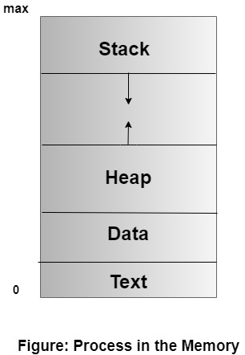

Slide 5
Process State
As a process executes, it changes state. The state of a process is defined in part by the current activity of that process. A process may be in one of the following states:
New: The process is being created.
Running: Instructions are being executed.
Waiting: The process is waiting for some event to occur (such as an I/O completion or reception of a signal).
Ready: The process is waiting to be assigned to a processor.
Terminated: The process has finished execution.

Slide 6
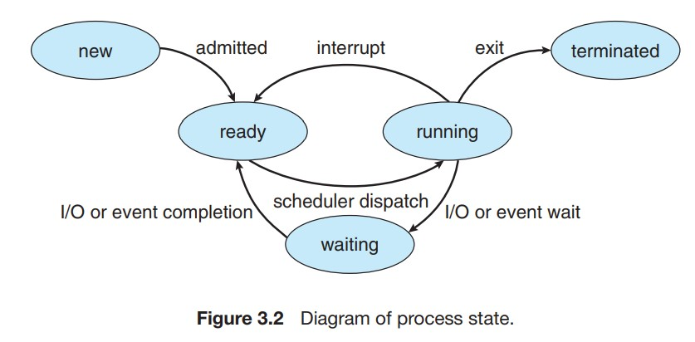

Slide 7
Process Control Block
The Process Control Block (PCB) in an operating system is a data structure that stores essential information about an individual process or task.
It is also known as the Task Control Block (TCB) or Control Block in some operating systems.
The PCB is a fundamental concept in process management and plays a crucial role in enabling multitasking and coordinating the execution of multiple processes in a system.
Each process in an operating system is represented by its unique PCB. When a process is created, the operating system allocates memory for its PCB, populates it with relevant information, and keeps it in the system’s process table.
The PCB remains associated with the process throughout its lifetime, even if the process is temporarily suspended or preempted.

Slide 8
Role of Process Control Block
The PCB contains various pieces of information related to the process, including:
Process State: The current state of the process, such as running, ready, waiting, or terminated. The operating system uses this information to schedule and manage the execution of processes effectively.
Process Identifier (PID): A unique numeric identifier assigned to each process, allowing the operating system to distinguish between different processes.
Program Counter (PC): A pointer to the address of the next instruction to be executed in the process. When the process is suspended and later resumed, the PC helps to continue execution from the last point.

Slide 9
CPU Registers: The contents of the CPU registers, including general-purpose registers and special-purpose registers. The operating system saves these registers in the PCB during a context switch to facilitate process switching.
Memory Management Information: Details about the memory allocated to the process, including base and limit registers or page tables, which help in memory protection and addressing.
Priority: The priority of the process, which determines its importance and influences the process scheduling algorithm.

Slide 10
Parent and Child Process Relationship: Information about the parent process (creator) and any child processes created by this process.
File Descriptors: A list of open files associated with the process, allowing the process to access files and perform I/O operations.
Accounting Information: Statistics and accounting data, such as CPU time used, time of process creation, and resource usage, for monitoring and resource management purposes.

Slide 11
Threads
Thread is an execution unit that consists of its own program counter, a stack, and a set of registers where the program counter mainly keeps track of which instruction to execute next, a set of registers mainly hold its current working variables, and a stack mainly contains the history of execution
Threads are also termed as lightweight processes as they share common resources.
Threads are a popular way to improve the performance of an application.
Threads are mainly used to represent a software approach in order to improve the performance of an operating system just by reducing the overhead thread that is mainly equivalent to a classical process.

Slide 12
Components of Thread
A thread has the following three components:
Program Counter
Register Set
Stack space

Slide 13
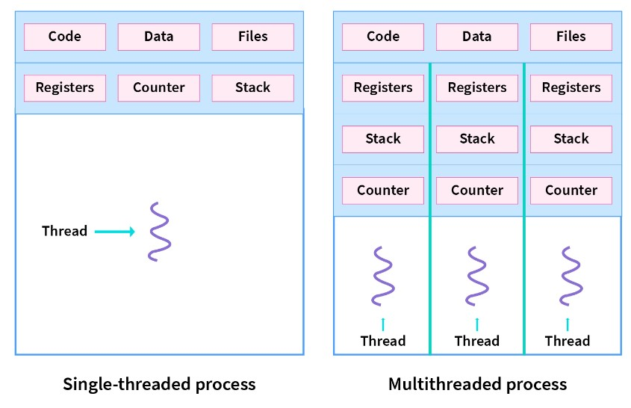

Slide 14
Types of threads
1. User Level Thread:
User-level threads are implemented and managed by the user and the kernel is not aware of it.
User-level threads are implemented using user-level libraries and the OS does not recognize these threads.
User-level thread is faster to create and manage compared to kernel-level thread.
Context switching in user-level threads is faster.
If one user-level thread performs a blocking operation then the entire process gets blocked. Eg: POSIX threads, Java threads, etc.

Slide 15
2. Kernel level Thread:
Kernel level threads are implemented and managed by the OS.
Kernel level threads are implemented using system calls and Kernel level threads are recognized by the OS.
Kernel-level threads are slower to create and manage compared to user-level threads.
Context switching in a kernel-level thread is slower.
Even if one kernel-level thread performs a blocking operation, it does not affect other threads. Eg: Window Solaris.

Slide 16
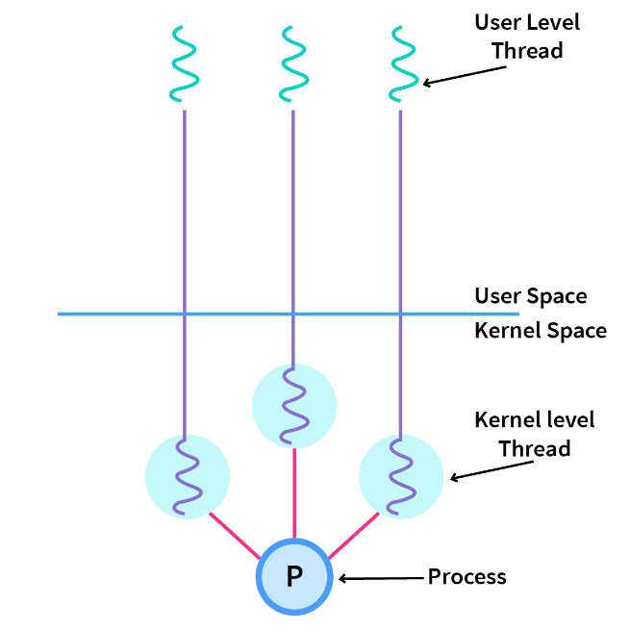

Slide 17
Difference between Process and Thread
Process simply means any program in execution
Processes use more resources and hence they are termed as heavyweight processes.
Creation and termination times of processes are slower.
Processes have their own code and data/file.
Communication between processes is slower.
Context Switching in processes is slower.
Processes are independent of each other.
Eg: Opening two different browsers.
Thread is a segment of a process
Threads share resources and hence they are termed as lightweight processes.
Creation and termination times of threads are faster compared to processes.
Processes have their own code and data/file.
Communication between threads id faster
Context Switching in processes is slower.
Threads, on the other hand, are interdependent. (i.e they can read, write or change another thread’s data)
Eg: Opening two tabs in the same browser.

Slide 18
Process Scheduling
The process scheduling is the activity of the process manager that handles the removal of the running process from the CPU and the selection of another process on the basis of a particular strategy.
The prime aim of the process scheduling system is to keep the CPU busy all the time and to deliver minimum response time for all programs.
The objective of multiprogramming is to have some process running at all times, to maximize CPU utilization.

Slide 19
The objective of time sharing is to switch the CPU among processes so frequently that users can interact with each program while it is running.
To meet these objectives, the process scheduler selects an available process (possibly from a set of several available processes) for program execution on the CPU.
For a single processor system, there will never be more than one running process.
If there are more processes, the rest will have to wait until the CPU is free and can be rescheduled.

Slide 20
What are Scheduling Queues?
All processes, upon entering into the system, are stored in the job queue.
Processes in the ready state are placed in the Ready Queue.
Processes waiting for a device to become available are placed in Device queues. There are unique device queues available for each I/O device.
A new process is initially put in the Ready queue. It waits in the ready queue until it is selected for execution(or dispatched). Once the process is assigned to the CPU and is executing, one of the following several events can occur:

Slide 21
The process could issue an I/O request, and then be placed in the I/O queue.
The process could create a new subprocess and wait for its termination.
The process could be removed forcibly from the CPU, as a result of an interrupt, and be put back in the ready queue.
In the first two cases, the process eventually switches from the waiting state to the ready state, and is then put back in the ready queue. A process continues this cycle until it terminates, at which time it is removed from all queues and has its PCB and resources deallocated.

Slide 22
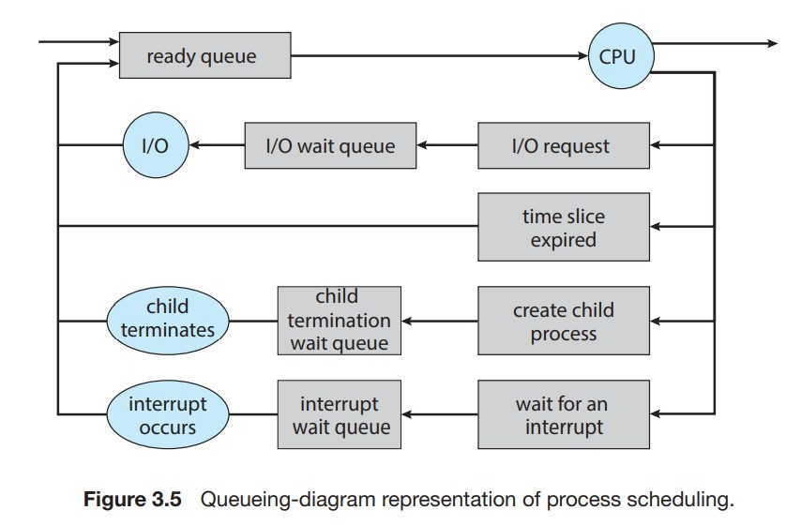

Slide 23
Types of Schedulers
There are three types of schedulers available:
Long Term Scheduler
Short Term Scheduler
Medium Term Scheduler

Slide 24
Long Term Scheduler
Job scheduler is another name for it.
Long term scheduler runs less frequently.
Long Term Schedulers decide which program must get into the job queue.
From the job queue, the Job Processor, selects processes and loads them into the memory for execution.
Primary aim of the Job Scheduler is to maintain a good degree of Multiprogramming.
An optimal degree of Multiprogramming means the average rate of process creation is equal to the average departure rate of processes from the execution memory.

Slide 25
Short Term Scheduler
This is also known as CPU Scheduler or dispatcher and runs very frequently.
The primary aim of this scheduler is to enhance CPU performance and increase process execution rate.

Slide 26
Medium Term Scheduler
This scheduler removes the processes from memory (and from active contention for the CPU), and thus reduces the degree of multiprogramming.
At some later time, the process can be reintroduced into memory and its execution can be continued where it left off.
This scheme is called swapping.
The process is swapped out, and is later swapped in, by the medium term scheduler.
Swapping may be necessary to improve the process mix, or because a change in memory requirements has overcommitted available memory, requiring memory to be freed up.
This complete process is descripted in the below diagram:

Slide 27
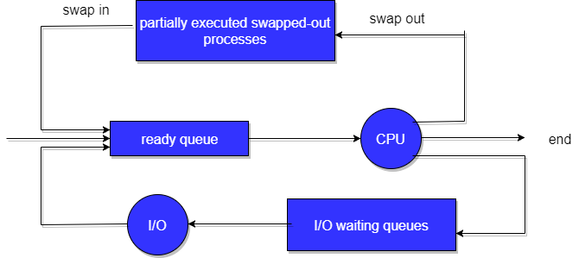
Addition of Medium-term scheduling to the queueing diagram

Slide 28
Context Switch
Switching the CPU to another process requires saving the state of the old process and loading the saved state for the new process. This task is known as a Context Switch.
The context of a process is represented in the Process Control Block(PCB) of a process; it includes the value of the CPU registers, the process state and memory-management information.
When a context switch occurs, the Kernel saves the context of the old process in its PCB and loads the saved context of the new process scheduled to run.

Slide 29
3.Context switch time is pure overhead, because the system does no useful work while switching.
Its speed varies from machine to machine, depending on the memory speed, the number of registers that must be copied, and the existence of special instructions(such as a single instruction to load or store all registers).
Typical speeds range from 1 to 1000 microseconds.
4.Context Switching has become such a performance bottleneck that programmers are using new structures(threads) to avoid it whenever and wherever possible.

Slide 30
1. Preemptive Scheduling:
Preemptive scheduling is used when a process switches from running state to ready state or from the waiting state to ready state.
The resources (mainly CPU cycles) are allocated to the process for a limited amount of time and then taken away, and the process is again placed back in the ready queue if that process still has CPU burst time remaining.
That process stays in the ready queue till it gets its next chance to execute.
Algorithms based on preemptive scheduling are: Round Robin (RR),Shortest Remaining Time First (SRTF), Priority (preemptive version), etc.

Slide 31
2. Non-Preemptive Scheduling:
Non-preemptive Scheduling is used when a process terminates, or a process switches from running to the waiting state.
In this scheduling, once the resources (CPU cycles) are allocated to a process, the process holds the CPU till it gets terminated or reaches a waiting state.
In the case of non-preemptive scheduling does not interrupt a process running CPU in the middle of the execution.
Instead, it waits till the process completes its CPU burst time, and then it can allocate the CPU to another process.
Algorithms based on non-preemptive scheduling are: Shortest Job First (SJF basically non preemptive) and Priority (non preemptive version), etc.

Slide 32
Dispatcher
The dispatcher is done after the scheduler.
It gives control of the CPU to the process selected by the short-term scheduler.
After selecting the process, the dispatcher gives CPU to it.
Functions
Switching context.
Switching to user mode.
Jumping to the proper location in the user program to reboot that program
Managing dispatch latency (time consumed by dispatcher is referred as dispatch latency)

Slide 33
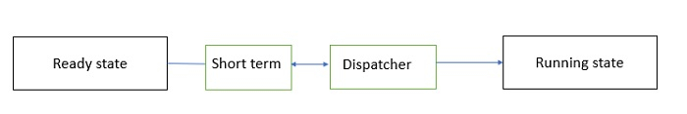
Fig. Dispatcher

Slide 34
For example,
Suppose there are 5 processes P1, P2, P3, P4, and P5.
The arrival times of these processes are T1, T2, T3, T4, and T5.
Here, FIFO (first in first out) algorithm is used. So, P1 comes first, and then the scheduler will choose that it is the first process that is going to execute.
The dispatcher will eliminate P1 from ready queue and take it to the CPU.
Now, the scheduler will select P2, which will be executed after P1.
The dispatcher removes P2 from the ready queue and gives it to the CPU.
This carries on in a similar way for processes P3, P4, and P5.
This is how a dispatcher works.
The scheduler provides the dispatcher with an ordered list of processes that the dispatcher gives to the CPU.
The dispatcher does many tasks such as memory mapping, context switching and setting up user registers.

Slide 35
Scheduling Criteria
The criteria include the following:
CPU utilization: We want to keep the CPU as busy as possible. Conceptually, CPU utilization can range from 0 to 100 percent. In a real system, it should range from 40 percent (for a lightly loaded system) to 90 percent (for a heavily loaded system). (CPU utilization can be obtained by using the top command on Linux, macOS, and UNIX systems.)
Throughput: If the CPU is busy executing processes, then work is being done. One measure of work is the number of processes that are completed per time unit, called throughput. For long processes, this rate may be one process over several seconds; for short transactions, it may be tens of processes per second.

Slide 36
Turnaround time: From the point of view of a particular process, the important criterion is how long it takes to execute that process. The interval from the time of submission of a process to the time of completion is the turnaround time. Turnaround time is the sum of the periods spent waiting in the ready queue, executing on the CPU, and doing I/O.
Waiting time: The CPU-scheduling algorithm does not affect the amount of time during which a process executes or does I/O. It affects only the amount of time that a process spends waiting in the ready queue. Waiting time is the sum of the periods spent waiting in the ready queue.

Slide 37
Response time: In an interactive system, turnaround time may not be the best criterion. Often, a process can produce some output fairly early and can continue computing new results while previous results are being output to the user. Thus, another measure is the time from the submission of a request until the first response is produced. This measure, called response time, is the time it takes to start responding, not the time it takes to output the response.

Slide 38
Scheduling algorithms
Scheduling algorithm is a way or selecting a process from ready queue and put it in the CPU.

Slide 39
FCFS(FIRST COME FIRST SERVE)
First Come First Serve (FCFS) is an operating system scheduling algorithm that automatically executes queued requests and processes in order of their arrival.
It is the easiest and simplest CPU scheduling algorithm. In this type of algorithm, processes which requests the CPU first get the CPU allocation first.
This is managed with a FIFO queue. The full form of FCFS is First Come First Serve.
As the process enters the ready queue, its PCB (Process Control Block) is linked with the tail of the queue and, when the CPU becomes free, it should be assigned to the process at the beginning of the queue.

Slide 40
CHARACTERISTICS
Jobs are always executed on a first-come, first-serve basis.
It is easy to implement and use.
This method is poor in performance, and the general wait time is quite high.
Example of FCFS scheduling
A real-life example of the FCFS method is buying a movie ticket on the ticket counter. In this scheduling algorithm, a person is served according to the queue manner.
The person who arrives first in the queue first buys the ticket and then the next one.
This will continue until the last person in the queue purchases the ticket.
Using this algorithm, the CPU process works in a similar manner.

Slide 41
How FCFS Works? Calculating Average Waiting Time
Here is an example of five processes arriving at different times. Each process has a different burst time.
Q1.
Process | Burst time | Arrival time
P1 | 6 | 2
P2 | 2 | 5
P3 | 8 | 1
P4 | 3 | 0
P5 | 4 | 4

Slide 42
Q2.
Process | Burst Time
P1 | 24
P2 | 3
P3 | 3

Slide 43
Q3.
Process | Arrival time | Burst time
P1 | 3 | 4
P2 | 5 | 3
P3 | 0 | 2
P4 | 5 | 1
P5 | 4 | 3

Slide 44
Q4
Process | Arrival time | Burst time
P1 | 0 | 2
P2 | 3 | 1
P3 | 5 | 6

Slide 45
Shortest job first
Shortest Job First (SJF) is an algorithm in which the process having the smallest execution time is chosen for the next execution.
This scheduling method can be preemptive or non-preemptive.
It significantly reduces the average waiting time for other processes awaiting execution.
The full form of SJF is Shortest Job First.

Slide 46
There are basically two types of SJF methods:
Non Pre-emptive SJF
Pre-emptive SJF
Characteristics of SJF Scheduling
It is associated with each job as a unit of time to complete.
This algorithm method is helpful for batch-type processing, where waiting for jobs to complete is not critical.
It can improve process throughput by making sure that shorter jobs are executed first, hence possibly have a short turnaround time.
It improves job output by offering shorter jobs, which should be executed first, which mostly have a shorter turnaround time.

Slide 47
Non Pre-emptive SJF
In non-preemptive scheduling, once the CPU cycle is allocated to process, the process holds it till it reaches a waiting state or terminated.
Pre-emptive SJF
In Preemptive SJF Scheduling, jobs are put into the ready queue as they come.
A process with shortest burst time begins execution.
If a process with even a shorter burst time arrives, the current process is removed or preempted from execution, and the shorter job is allocated CPU cycle.

Slide 48
Process | Arrival time | Burst time
P1 | 1 | 3
P2 | 2 | 4
P3 | 1 | 2
P4 | 4 | 4

Slide 49
PROCESS | BURST TIME
P1 | 6
P2 | 8
P3 | 7
P4 | 3

Slide 50
PROCESS | ARR1IVAL TIME | BUSRT TIME
P1 | 0 | 8
P2 | 1 | 4
P3 | 2 | 9
P40 | 3 | 5

Slide 51
PROCESS | ARRIVAL TIME | BURST TIME
P1 | 0 | 12
P2 | 2 | 4
P3 | 3 | 6
P4 | 8 | 5

Slide 52
Round robin algorithm
The round-robin (RR) scheduling algorithm is similar to FCFS scheduling, but preemption is added to enable the system to switch between processes.
A small unit of time, called a time quantum or time slice, is defined.
A time quantum is generally from 10 to 100 milliseconds in length.
The ready queue is treated as a circular queue.
The CPU scheduler goes around the ready queue, allocating the CPU to each process for a time interval of up to 1 time quantum.
To implement RR scheduling, we again treat the ready queue as a FIFO queue of processes.
New processes are added to the tail of the ready queue.

Slide 53
The CPU scheduler picks the first process from the ready queue, sets a timer to interrupt after 1 time quantum, and dispatches the process.
One of two things will then happen. The process may have a CPU burst of less than 1 time quantum.
In this case, the process itself will release the CPU voluntarily.
The scheduler will then proceed to the next process in the ready queue.
If the CPU burst of the currently running process is longer than 1 time quantum, the timer will go off and will cause an interrupt to the operating system.
A context switch will be executed, and the process will be put at the tail of the ready queue.
The CPU scheduler will then select the next process in the ready queue.

Slide 54
Advantages of round robin
It doesn’t face the issues of starvation or convoy effect.
All the jobs get a fair allocation of CPU.
It deals with all process without any priority
If you know the total number of processes on the run queue, then you can also assume the worst-case response time for the same process.
This scheduling method does not depend upon burst time. That’s why it is easily implementable on the system.
Once a process is executed for a specific set of the period, the process is preempted, and another process executes for that given time period.
Allows OS to use the Context switching method to save states of preempted processes.
It gives the best performance in terms of average response time.

Slide 55
Disadvantages of Round-robin Scheduling
If slicing time of OS is low, the processor output will be reduced.
This method spends more time on context switching
Its performance heavily depends on time quantum.
Priorities cannot be set for the processes.
Round-robin scheduling doesn’t give special priority to more important tasks.
Decreases comprehension
Lower time quantum results in higher the context switching overhead in the system.
Finding a correct time quantum is a quite difficult task in this system.

Slide 56
Priority scheduling
Priority Scheduling is a method of scheduling processes that is based on priority.
In this algorithm, the scheduler selects the tasks to work as per the priority.
The processes with higher priority should be carried out first, whereas jobs with equal priorities are carried out on a round-robin or FCFS basis.
Priority depends upon memory requirements, time requirements, etc.

Slide 57
Types of Priority Scheduling
Preemptive Scheduling
In Preemptive Scheduling, the tasks are mostly assigned with their priorities.
Sometimes it is important to run a task with a higher priority before another lower priority task, even if the lower priority task is still running.
The lower priority task holds for some time and resumes when the higher priority task finishes its execution.
Non-Preemptive Scheduling
In this type of scheduling method, the CPU has been allocated to a specific process.
The process that keeps the CPU busy, will release the CPU either by switching context or terminating.
It is the only method that can be used for various hardware platforms.
That’s because it doesn’t need special hardware (for example, a timer) like preemptive scheduling.

Slide 58
Characteristics of Priority Scheduling
A CPU algorithm that schedules processes based on priority.
It used in Operating systems for performing batch processes.
If two jobs having the same priority are READY, it works on a FIRST COME, FIRST SERVED basis.
In priority scheduling, a number is assigned to each process that indicates its priority level.
Lower the number, higher is the priority.
In this type of scheduling algorithm, if a newer process arrives, that is having a higher priority than the currently running process, then the currently running process is preempted.

Slide 59
Disadvantages of Priority scheduling
If the system eventually crashes, all low priority processes get lost.
If high priority processes take lots of CPU time, then the lower priority processes may starve and will be postponed for an indefinite time.
This scheduling algorithm may leave some low priority processes waiting indefinitely.
A process will be blocked when it is ready to run but has to wait for the CPU because some other process is running currently.
If a new higher priority process keeps on coming in the ready queue, then the process which is in the waiting state may need to wait for a long duration of time.

Slide 60
Advantages of priority scheduling
Easy to use scheduling method
Processes are executed on the basis of priority so high priority does not need to wait for long which saves time
This method provides a good mechanism where the relative important of each process may be precisely defined.
Suitable for applications with fluctuating time and resource requirements.

Slide 61
Q1.
Process ID | Burst time | Priority
P1 | 10 | 3
P2 | 1 | 1
P3 | 2 | 4
P4 | 1 | 5
P5 | 5 | 2

Slide 62
Q2.
Process | Priority | Burst time | Arrival time
P1 | 1 | 4 | 0
P2 | 2 | 3 | 0
P3 | 1 | 7 | 6
P4 | 3 | 4 | 11
P5 | 2 | 2 | 12

Slide 63
Q3.
Consider the set of process with arrival time (in milliseconds), CPU burst time (in milliseconds) and priority shown below(higher number represents higher priority)
Process ID | Arrival time | Burst time | Priority
P1 | 0 | 4 | 2
P2 | 1 | 3 | 3
P3 | 2 | 1 | 4
P4 | 3 | 5 | 5
P5 | 4 | 2 | 5
If CPU scheduling policy is priority non pre emptive, Calculate the average waiting time and average turn around time.

Slide 64
Q5
Consider the set of process with arrival time (in milliseconds), CPU burst time (in milliseconds) and priority shown below (0 is the highest priority). None of the process have I/O burst time
Process ID | Arrival time | Burst time | Priority
P1 | 0 | 11 | 2
P2 | 5 | 28 | 0
P3 | 12 | 2 | 3
P4 | 2 | 10 | 1
P5 | 9 | 16 | 4
Find average waiting time.

Slide 65
Multilevel queue scheduling
Another class of scheduling algorithms has been created for situations in which processes are easily classified into different groups.
For example, A common division is made between foreground(or interactive) processes and background (or batch) processes.
These two types of processes have different response-time requirements, and so might have different scheduling needs.
In addition, foreground processes may have priority over background processes.
A multi-level queue scheduling algorithm partitions the ready queue into several separate queues.
The processes are permanently assigned to one queue, generally based on some property of the process, such as memory size, process priority, or process type.
Each queue has its own scheduling algorithm.

Slide 66
For example, separate queues might be used for foreground and background processes. The foreground queue might be scheduled by the Round Robin algorithm, while the background queue is scheduled by an FCFS algorithm.
In addition, there must be scheduling among the queues, which is commonly implemented as fixed-priority preemptive scheduling. For example, The foreground queue may have absolute priority over the background queue.
Let us consider an example of a multilevel queue-scheduling algorithm with five queues:
System Processes
Interactive Processes
Interactive Editing Processes
Batch Processes
Student Processes

Slide 67
Each queue has absolute priority over lower-priority queues.
No process in the batch queue, for example, could run unless the queues for system processes, interactive processes, and interactive editing processes were all empty.
If an interactive editing process entered the ready queue while a batch process was running, the batch process will be preempted.

Slide 68
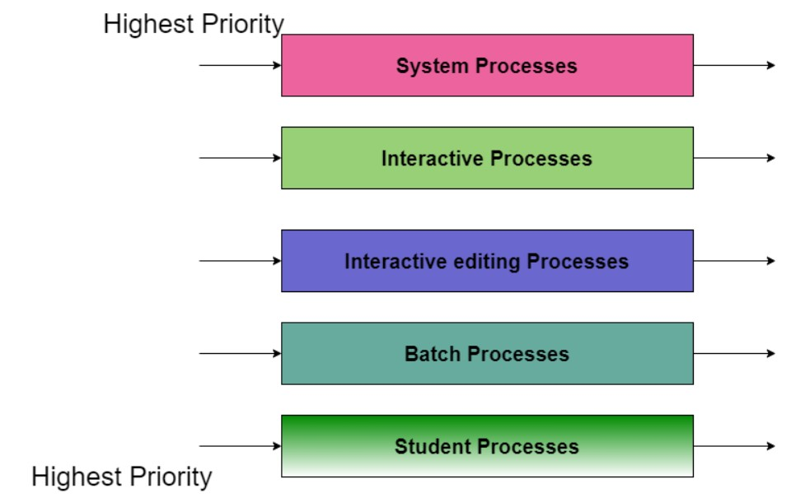

Lower Priority
Fig. Multilevel Queue Scheduling

Slide 69
In this case, if there are no processes on the higher priority queue only then the processes on the low priority queues will run.
For Example: Once processes on the system queue, the Interactive queue, and Interactive editing queue become empty, only then the processes on the batch queue will run.
The Description of the processes in the above diagram is as follows:
System Process The Operating system itself has its own process to run and is termed as System Process.
Interactive Process The Interactive Process is a process in which there should be the same kind of interaction (basically an online game ).

Slide 70
Batch Processes: Batch processing is basically a technique in the Operating system that collects the programs and data together in the form of the batch before the processing starts.
Student Process: The system process always gets the highest priority while the student processes always get the lowest priority.

Slide 71
Advantages of Multilevel Queue Scheduling
With the help of this scheduling we can apply various kind of scheduling for different kind of processes:
For System Processes: First Come First Serve(FCFS) Scheduling.
For Interactive Processes: Shortest Job First (SJF) Scheduling.
For Batch Processes: Round Robin(RR) Scheduling
For Student Processes: Priority Scheduling

Slide 72
Disadvantages of Multilevel Queue Scheduling
The main disadvantage of Multilevel Queue Scheduling is the problem of starvation for lower-level processes.
Starvation:
Due to starvation lower-level processes either never execute or have to wait for a long amount of time because of lower priority or higher priority process taking a large amount of time.

Slide 73
Multilevel Feedback Queue Scheduling
In a multilevel queue-scheduling algorithm, processes are permanently assigned to a queue on entry to the system.
Processes do not move between queues. This setup has the advantage of low scheduling overhead, but the disadvantage of being inflexible.
Multilevel feedback queue scheduling, however, allows a process to move between queues.
The idea is to separate processes with different CPU-burst characteristics.
If a process uses too much CPU time, it will be moved to a lower-priority queue.
Similarly, a process that waits too long in a lower-priority queue may be moved to a higher-priority queue.
This form of aging prevents starvation.

Slide 74
In general, a multilevel feedback queue scheduler is defined by the following parameters:
The number of queues.
The scheduling algorithm for each queue.
The method used to determine when to upgrade a process to a higher-priority queue.
The method used to determine when to demote a process to a lower-priority queue.
The method used to determine which queue a process will enter when that process needs service.
The definition of a multilevel feedback queue scheduler makes it the most general CPU-scheduling algorithm.
It can be configured to match a specific system under design.
Unfortunately, it also requires some means of selecting values for all the parameters to define the best scheduler.
Although a multilevel feedback queue is the most general scheme, it is also the most complex.

Slide 75
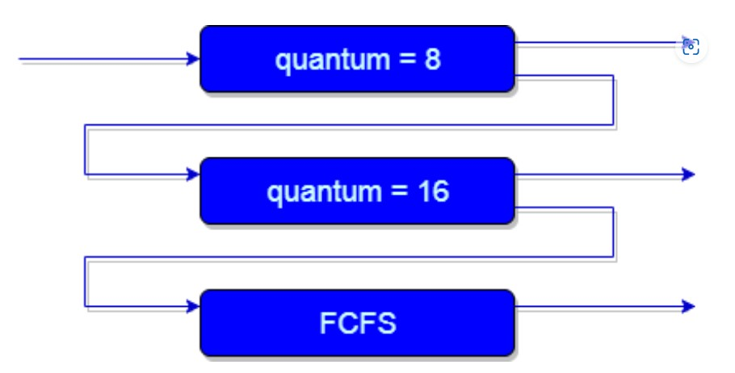
An example of a multilevel feedback queue can be seen in the above figure.

Slide 76
Explanation:
First of all, Suppose that queues 1 and 2 follow round robin with time quantum 8 and 16 respectively and queue 3 follows FCFS. One of the implementations of Multilevel Feedback Queue Scheduling is as follows:
If any process starts executing then firstly it enters queue 1.
In queue 1, the process executes for 8 unit and if it completes in these 8 units or it gives CPU for I/O operation in these 8 units unit than the priority of this process does not change, and if for some reasons it again comes in the ready queue than it again starts its execution in the Queue 1.
If a process that is in queue 1 does not complete in 8 units then its priority gets reduced and it gets shifted to queue 2.

Slide 77
4.Above points 2 and 3 are also true for processes in queue 2 but the time quantum is 16 units. Generally, if any process does not complete in a given time quantum then it gets shifted to the lower priority queue.
5.After that in the last queue, all processes are scheduled in an FCFS manner.
6.It is important to note that a process that is in a lower priority queue can only execute only when the higher priority queues are empty.
7.Any running process in the lower priority queue can be interrupted by a process arriving in the higher priority queue.
Also, the above implementation may differ for the example in which the last queue will follow Round-robin Scheduling.

Slide 78
In the above Implementation, there is a problem and that is; Any process that is in the lower priority queue has to suffer starvation due to some short processes that are taking all the CPU time.
And the solution to this problem is : There is a solution that is to boost the priority of all the process after regular intervals then place all the processes in the highest priority queue.

Slide 79
The need for Multilevel Feedback Queue Scheduling(MFQS)
Following are some points to understand the need for such complex scheduling:
This scheduling is more flexible than Multilevel queue scheduling.
This algorithm helps in reducing the response time.
In order to optimize the turnaround time, the SJF algorithm is needed which basically requires the running time of processes in order to schedule them. As we know that the running time of processes is not known in advance. Also, this scheduling mainly runs a process for a time quantum and after that, it can change the priority of the process if the process is long. Thus this scheduling algorithm mainly learns from the past behavior of the processes and then it can predict the future behavior of the processes. In this way, MFQS tries to run a shorter process first which in return leads to optimize the turnaround time.

Slide 80
Advantages of MFQS
This is a flexible Scheduling Algorithm
This scheduling algorithm allows different processes to move between different queues.
In this algorithm, A process that waits too long in a lower priority queue may be moved to a higher priority queue which helps in preventing starvation.

Slide 81
Disadvantages of MFQS
This algorithm is too complex.
As processes are moving around different queues which leads to the production of more CPU overheads.
In order to select the best scheduler this algorithm requires some other means to select the values.

Slide 82
Multiple Processor Scheduling
Multiple processor scheduling or multiprocessor scheduling focuses on designing the system's scheduling function, which consists of more than one processor.
Multiple CPUs share the load (load sharing) in multiprocessor scheduling so that various processes run simultaneously.
In general, multiprocessor scheduling is complex as compared to single processor scheduling.
In the multiprocessor scheduling, there are many processors, and they are identical, and we can run any process at any time.
The multiple CPUs in the system are in close communication, which shares a common bus, memory, and other peripheral devices.
So we can say that the system is tightly coupled.
These systems are used when we want to process a bulk amount of data, and these systems are mainly used in satellite, weather forecasting, etc.

Slide 83
There are cases when the processors are identical, i.e., homogenous, in terms of their functionality in multiple-processor scheduling.
We can use any processor available to run any process in the queue.
There may be special scheduling constraints, such as devices connected via a private bus to only one CPU.
There is no policy or rule which can be declared as the best scheduling solution to a system with a single processor.
Similarly, there is no best scheduling solution for a system with multiple processors as well.

Slide 84
Approaches to Multiple Processor Scheduling
There are two approaches to multiple processor scheduling in the operating system: Symmetric Multiprocessing and Asymmetric Multiprocessing.
Symmetric Multiprocessing: It is used where each processor is self-scheduling. All processes may be in a common ready queue, or each processor may have its private queue for ready processes. The scheduling proceeds further by having the scheduler for each processor examine the ready queue and select a process to execute.
Asymmetric Multiprocessing: It is used when all the scheduling decisions and I/O processing are handled by a single processor called the Master Server. The other processors execute only the user code. This is simple and reduces the need for data sharing, and this entire scenario is called Asymmetric Multiprocessing.

Slide 85
Processor Affinity
Processor Affinity means a process has an affinity for the processor on which it is currently running.
When a process runs on a specific processor, there are certain effects on the cache memory.
The data most recently accessed by the process populate the cache for the processor.
As a result, successive memory access by the process is often satisfied in the cache memory.
Now, suppose the process migrates to another processor.
In that case, the contents of the cache memory must be invalidated for the first processor, and the cache for the second processor must be repopulated.

Slide 86
Because of the high cost of invalidating and repopulating caches, most SMP(symmetric multiprocessing) systems try to avoid migrating processes from one processor to another and keep a process running on the same processor. This is known as processor affinity.
There are two types of processor affinity, such as:
Soft Affinity: When an operating system has a policy of keeping a process running on the same processor but not guaranteeing it will do so, this situation is called soft affinity.
Hard Affinity: Hard Affinity allows a process to specify a subset of processors on which it may run. Some Linux systems implement soft affinity and provide system calls like sched_setaffinity() that also support hard affinity.

Slide 87
Load Balancing
Load Balancing is the phenomenon that keeps the workload evenly distributed across all processors in an SMP system.
Load balancing is necessary only on systems where each processor has its own private queue of a process that is eligible to execute.
Load balancing is unnecessary because it immediately extracts a runnable process from the common run queue once a processor becomes idle.
On SMP (symmetric multiprocessing), it is important to keep the workload balanced among all processors to utilize the benefits of having more than one processor fully.
One or more processors will sit idle while other processors have high workloads along with lists of processors awaiting the CPU.

Slide 88
There are two general approaches to load balancing:
Push Migration:
In push migration, a task routinely checks the load on each processor.
If it finds an imbalance, it evenly distributes the load on each processor by moving the processes from overloaded to idle or less busy processors.
2.Pull Migration:
Pull Migration occurs when an idle processor pulls a waiting task from a busy processor for its execution.

Slide 89
Multi-core Processors
In multi-core processors, multiple processor cores are placed on the same physical chip.
Each core has a register set to maintain its architectural state and thus appears to the operating system as a separate physical processor.
SMP systems that use multi-core processors are faster and consume less power than systems in which each processor has its own physical chip.

Slide 90
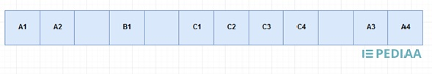
Coarse-Grained Multithreading:
In coarse grained multithreading, a thread issues instructions until thread issuing stops. The process is also called stalling.
When a stall occurs, the next thread starts issuing instructions. At this point, a cycle is lost due to this thread switching.
Consider the same example used in fine grained multithreading.
Thread A issues first and second instructions.
As it stops issuing instructions, the control passes to thread B, and there is one clock cycle loss.
Thread B executes the first instructions, and it stops.
Then the control passes to C, and there is one clock cycle loss.
Thread C issues four instructions before it stops issuing instructions.
Then the control passes back to A.
There is a clock cycle loss and thread A issues third and fourth instructions. And, this process continues.

Slide 91
2.Fine-Grained Multithreading:
In fine grained multithreading, the threads are executed in a round-robin fashion in consecutive cycles.
For example, assume a computer can issue one instruction per clock cycle. A, B, C are three threads.
The first 12 cycles of those threads are as follows.

Slide 92
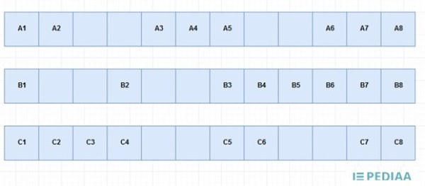
Figure 1: Example
The way of these threads issuing instructions according to fine grained multithreading is as follows.

Slide 93
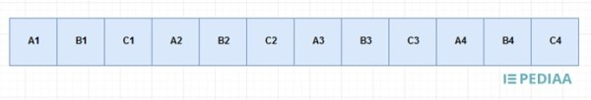
Each thread issues their first instruction.
Thread A issues its second instruction.
There should be 2 clock cycles between B1 and B2.
As 2 clock cycles have already passed, it is possible to issue second instruction of Thread B.
After that, thread C issues its second instruction. And, this process continues.

Slide 94
Real time scheduling
Systems that carry real-time tasks are known as real-time systems.
These tasks can be divided into two categories:
Soft real-time tasks: The task can be rescheduled.
Hard real-time tasks: The tasks need to be performed within a certain time period.
In this system, the scheduler is considered the most important component.
The scheduler aims to reduce the response time for each process.

Slide 95
Real-time scheduling algorithms:
In a simple real-time system, there might be no need for a scheduler, one task can simply call the next.
But for more complex real-time systems, that have a large but fixed number of tasks that do not function in pipeline function, one may need static scheduling.
And for real-time systems where the workload keeps changing, one may need dynamic scheduling.

Slide 96
In dynamic scheduling two important question arises:
1.How to handle the overload?
To handle the overload these processes can be used:
Best efforts
Work shedding
2.How to choose which process to execute first?
To decide which process to execute first from the ready queue these methods may be used:
SJF
Static priority
Slack time.

Slide 97
Thread scheduling
Scheduling of threads involves two boundary scheduling,
Scheduling of user level threads (ULT) to kernel level threads (KLT) via lightweight process (LWP) by the application developer.
Scheduling of kernel level threads by the system scheduler to perform different unique OS functions.

Slide 98
Light weight Process (LWP) :
Light-weight process are threads in the user space that acts as an interface for the ULT to access the physical CPU resources.
Thread library schedules which thread of a process to run on which LWP and how long.
The number of LWP created by the thread library depends on the type of application.
In the case of an I/O bound application, the number of LWP depends on the number of user-level threads.
This is because when an LWP is blocked on an I/O operation, then to invoke the other ULT the thread library needs to create and schedule another LWP.
Thus, in an I/O bound application, the number of LWP is equal to the number of the ULT. In the case of a CPU bound application, it depends only on the application.
Each LWP is attached to a separate kernel-level thread.

Slide 99
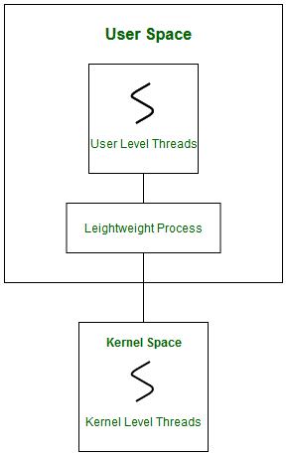

Slide 100
In real-time, the first boundary of thread scheduling is beyond specifying the scheduling policy and the priority.
It requires two controls to be specified for the User level threads: Contention scope, and Allocation domain.
These are explained as following below.

Slide 101
1. Contention Scope :
The word contention here refers to the competition or fight among the User level threads to access the kernel resources.
Thus, this control defines the extent to which contention takes place.
It is defined by the application developer using the thread library.
Depending upon the extent of contention it is classified as Process Contention Scope and System Contention Scope.

Slide 102
Process Contention Scope (PCS) –
The contention takes place among threads within a same process.
The thread library schedules the high-prioritized PCS thread to access the resources via available LWPs (priority as specified by the application developer during thread creation).
System Contention Scope (SCS) –
The contention takes place among all threads in the system.
In this case, every SCS thread is associated to each LWP by the thread library and are scheduled by the system scheduler to access the kernel resources.
In LINUX and UNIX operating systems, the POSIX Pthread library provides a function Pthread_attr_setscope to define the type of contention scope for a thread during its creation. (POSIX (Portable Operating System Interface) is a set of standard operating system interfaces based on the Unix operating system.)

Slide 103

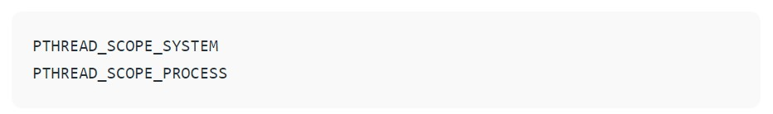
The first parameter denotes to which thread within the process the scope is defined. The second parameter defines the scope of contention for the thread pointed. It takes two values.
If the scope value specified is not supported by the system, then the function returns ENOTSUP (Operation not supported (POSIX.1-2001)).

Slide 104
2. Allocation Domain :
The allocation domain is a set of one or more resources for which a thread is competing.
In a multicore system, there may be one or more allocation domains where each consists of one or more cores.
One ULT can be a part of one or more allocation domain.
Due to this high complexity in dealing with hardware and software architectural interfaces, this control is not specified.
But by default, the multicore system will have an interface that affects the allocation domain of a thread.

Slide 105
Consider a scenario, an operating system with three process P1, P2, P3 and 10 user level threads (T1 to T10) with a single allocation domain.
100% of CPU resources will be distributed among all the three processes.
The amount of CPU resources allocated to each process and to each thread depends on the contention scope, scheduling policy and priority of each thread defined by the application developer using thread library and also depends on the system scheduler.
These User level threads are of a different contention scope.

Slide 106
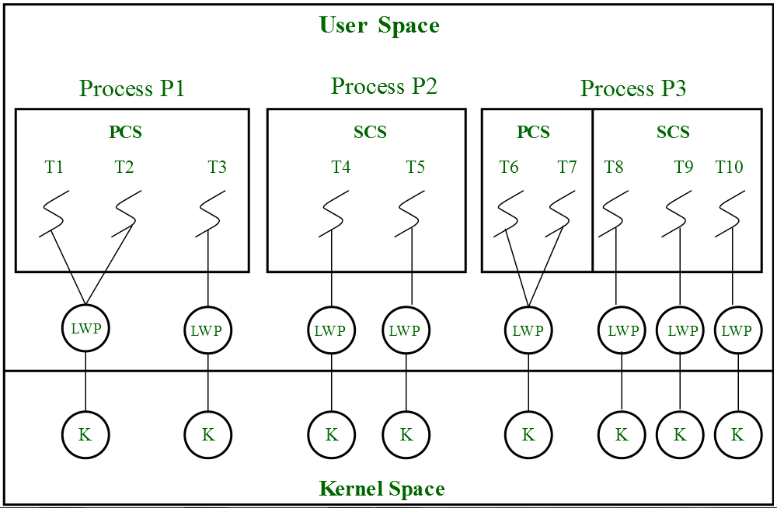
In this case, the contention for allocation domain takes place as follows,

Slide 107
1.Process P1:
All PCS threads T1, T2, T3 of Process P1 will compete among themselves. The PCS threads of the same process can share one or more LWP.
T1 and T2 share an LWP and T3 are allocated to a separate LWP.
Between T1 and T2 allocation of kernel resources via LWP is based on preemptive priority scheduling by the thread library.
A Thread with a high priority will preempt low priority threads.
Whereas, thread T1 of process p1 cannot preempt thread T3 of process p3 even if the priority of T1 is greater than the priority of T3.
If the priority is equal, then the allocation of ULT to available LWPs is based on the scheduling policy of threads by the system scheduler(not by thread library, in this case).

Slide 108
2.Process P2:
Both SCS threads T4 and T5 of process P2 will compete with processes P1 as a whole and with SCS threads T8, T9, T10 of process P3.
The system scheduler will schedule the kernel resources among P1, T4, T5, T8, T9, T10, and PCS threads (T6, T7) of process P3 considering each as a separate process.
Here, the Thread library has no control of scheduling the ULT to the kernel resources.

Slide 109
3.Process P3:
Combination of PCS and SCS threads.
Consider if the system scheduler allocates 50% of CPU resources to process P3, then 25% of resources is for process scoped threads and the remaining 25% for system scoped threads.
The PCS threads T6 and T7 will be allocated to access the 25% resources based on the priority by the thread library.
The SCS threads T8, T9, T10 will divide the 25% resources among themselves and access the kernel resources via separate LWP and KLT.
The SCS scheduling is by the system scheduler.

Slide 110
Process Synchronization
Process Synchronization was introduced to handle problems that arose while multiple process executions.
Process is categorized into two types on the basis of synchronization and these are given below:
Independent Process
Cooperative Process

Slide 111
Independent Processes
Two processes are said to be independent if the execution of one process does not affect the execution of another process.
Cooperative Processes
Two processes are said to be cooperative if the execution of one process affects the execution of another process. These processes need to be synchronized so that the order of execution can be guaranteed.

Slide 112
Process synchronization
It is the task phenomenon of coordinating the execution of processes in such a way that no two processes can have access to the same shared data and resources.
It is a procedure that is involved in order to preserve the appropriate order of execution of cooperative processes.
In order to synchronize the processes, there are various synchronization mechanisms.
Process Synchronization is mainly needed in a multi-process system when multiple processes are running together, and more than one processes try to gain access to the same shared resource or any data at the same time.

Slide 113
Race Condition
At the time when more than one process is either executing the same code or accessing the same memory or any shared variable;
In that condition, there is a possibility that the output or the value of the shared variable is wrong so for that purpose all the processes are doing the race to say that my output is correct.
This condition is commonly known as a race condition.
As several processes access and process the manipulations on the same data in a concurrent manner and due to which the outcome depends on the particular order in which the access of data takes place.
Mainly this condition is a situation that may occur inside the critical section.
Race condition in the critical section happens when the result of multiple thread execution differs according to the order in which the threads execute.
But this condition is critical sections can be avoided if the critical section is treated as an atomic instruction.
Proper thread synchronization using locks or atomic variables can also prevent race conditions.

Slide 114
Critical Section Problem
A critical section code segment that accesses shared variables and has to be executed as an atomic action.
It means that in a group of cooperating processes, at a given point of time, only one process must be executing its critical section.
If any other process also wants to execute its critical section, it must wait until the first one finishes.
The entry to the critical section is mainly handled by wait() function while the exit from critical section is controlled by signal() function.

Slide 115
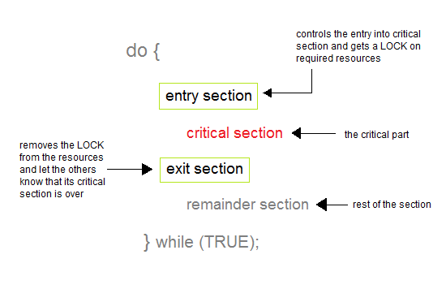

Slide 116
Entry Section
In this section mainly the process requests for its entry in the critical section.
Exit Section
This section is followed by the critical section.

Slide 117
The solution to the Critical Section Problem
A solution to the critical section problem must satisfy the following three conditions:
1.Mutual Exclusion
Out of a group of cooperating processes, only one process can be in its critical section at a given point of time.
2. Progress
If no process is in its critical section, and if one or more threads want to execute their critical section then any one of these threads must be allowed to get into its critical section.
3. Bounded Waiting
After a process makes a request for getting into its critical section, there is a limit for how many other processes can get into their critical section, before this process's request is granted. So after the limit is reached, the system must grant the process permission to get into its critical section.

Slide 118
Solutions for the Critical Section
The critical section plays an important role in Process Synchronization so that the problem must be solved.
Some widely used method to solve the critical section problem are as follows:

Slide 119
1.Peterson's Solution
This is widely used and software-based solution to critical section problems.
Peterson's solution was developed by a computer scientist Peterson that's why it is named so.
With the help of this solution whenever a process is executing in any critical state, then the other process only executes the rest of the code, and vice-versa can happen.
This method also helps to make sure of the thing that only a single process can run in the critical section at a specific time.

Slide 120
This solution preserves all three conditions:
Mutual Exclusion is comforted as at any time only one process can access the critical section.
Progress is also comforted, as a process that is outside the critical section is unable to block other processes from entering into the critical section.
Bounded Waiting is assured as every process gets a fair chance to enter the Critical section.

Slide 121
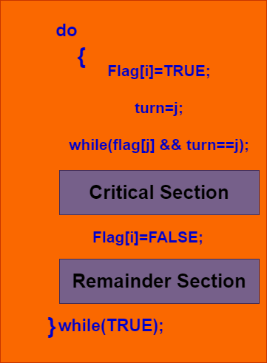

Slide 122
The above shows the structure of process Pi in Peterson's solution.
Suppose there are N processes (P1, P2, ... PN) and as at some point of time every process requires to enter in the Critical Section
A FLAG[] array of size N is maintained here which is by default false. Whenever a process requires to enter in the critical section, it has to set its flag as true. Example: If Pi wants to enter it will set FLAG[i]=TRUE.
Another variable is called TURN and is used to indicate the process number that is currently waiting to enter into the critical section.
The process that enters into the critical section while exiting would change the TURN to another number from the list of processes that are ready.
Example: If the turn is 3 then P3 enters the Critical section and while exiting turn=4 and therefore P4 breaks out of the wait loop.

Slide 123
Semaphore
Semaphore is simply a variable that is non-negative and shared between threads.
A semaphore is a signaling mechanism, and a thread that is waiting on a semaphore can be signaled by another thread.
It uses two atomic operations, 1) Wait, and 2) Signal for the process synchronization.
A semaphore either allows or disallows access to the resource, which depends on how it is set up.
The two common kinds of semaphores are
Counting semaphores
Binary semaphores.

Slide 124
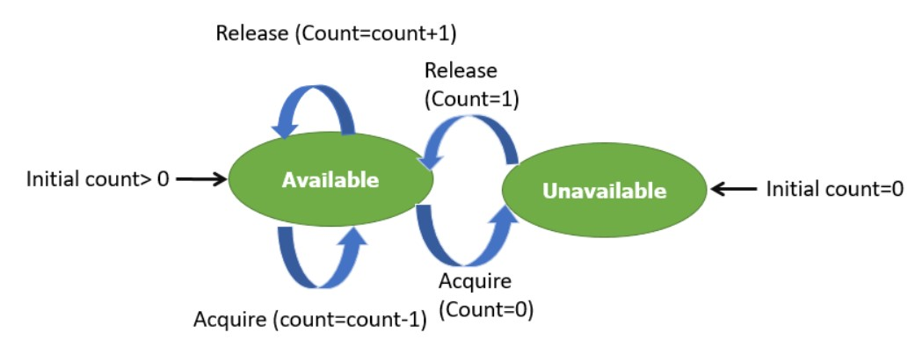
Counting Semaphores
This type of Semaphore uses a count that helps task to be acquired or released numerous times.
If the initial count = 0, the counting semaphore should be created in the unavailable state.
However, If the count is > 0, the semaphore is created in the available state, and the number of tokens it has equals to its count.

Slide 125
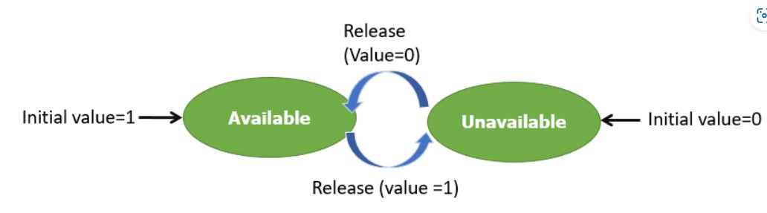
Binary Semaphores
The binary semaphores are quite similar to counting semaphores, but their value is restricted to 0 and 1.
In this type of semaphore, the wait operation works only if semaphore = 1, and the signal operation succeeds when semaphore= 0.
It is easy to implement than counting semaphores.

Slide 126
Wait and Signal Operations in Semaphores
Both of these operations are used to implement process synchronization. The goal of this semaphore operation is to get mutual exclusion.
Wait for Operation
This type of semaphore operation helps you to control the entry of a task into the critical section. However, If the value of wait is positive, then the value of the wait argument X is decremented. In the case of negative or zero value, no operation is executed. It is also called P(S) operation.
After the semaphore value is decreased, which becomes negative, the command is held up until the required conditions are satisfied

Slide 127
Copy CodeP(S)
{
while (S<=0);
S--;
}

Slide 128
Signal operation
This type of Semaphore operation is used to control the exit of a task from a critical section. It helps to increase the value of the argument by 1, which is denoted as V(S).
Copy Code P(S)
{
while (S>=0);
S++;
}

Slide 129
Counting Semaphore vs. Binary Semaphore
Counting Semaphore | Binary Semaphore
No mutual exclusion | Mutual exclusion
Any integer value | Value only 0 and 1
More than one slot | Only one slot
Provide a set of Processes | It has a mutual exclusion mechanism.

Slide 130
Classical Problems of Synchronization
The classical problems of synchronization are as follows:
Bound-Buffer problem
Sleeping barber problem
Dining Philosophers problem
Readers and writers problem

Slide 131
Bound-Buffer problem
Also known as the Producer-Consumer problem. In this problem, there is a buffer of n slots, and each buffer is capable of storing one unit of data.
There are two processes that are operating on the buffer – Producer and Consumer.
The producer tries to insert data and the consumer tries to remove data.
If the processes are run simultaneously they will not yield the expected output.
The solution to this problem is creating two semaphores, one full and the other empty to keep a track of the concurrent processes.

Slide 132
Sleeping Barber Problem
This problem is based on a hypothetical barbershop with one barber.
When there are no customers the barber sleeps in his chair.
If any customer enters he will wake up the barber and sit in the customer chair.
If there are no chairs empty they wait in the waiting queue.

Slide 133
Dining Philosopher’s problem
This problem states that there are K number of philosophers sitting around a circular table with one chopstick placed between each pair of philosophers.
The philosopher will be able to eat if he can pick up two chopsticks that are adjacent to the philosopher.
This problem deals with the allocation of limited resources.

Slide 134
Readers and Writers Problem
This problem occurs when many threads of execution try to access the same shared resources at a time.
Some threads may read, and some may write. In this scenario, we may get faulty outputs.

Slide 135
Monitors in process synchronization
The monitor is one of the ways to achieve Process synchronization. The monitor is supported by programming languages to achieve mutual exclusion between processes. For example Java Synchronized methods. Java provides wait() and notify() constructs.
It is the collection of condition variables and procedures combined together in a special kind of module or a package.
The processes running outside the monitor can’t access the internal variable of the monitor but can call procedures of the monitor.
Only one process at a time can execute code inside monitors.

Slide 136
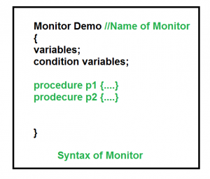
Syntax:

Slide 137
Condition Variables: Two different operations are performed on the condition variables of the monitor.
Wait. signal
let say we have 2 condition variables condition x, y; // Declaring variable

Slide 138
Wait operation
x.wait() : Process performing wait operation on any condition variable are suspended. The suspended processes are placed in block queue of that condition variable.
Note: Each condition variable has its unique block queue.

Slide 139
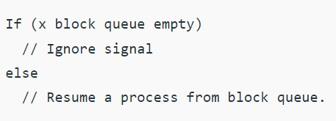
Signal operation x.signal(): When a process performs signal operation on condition variable, one of the blocked processes is given chance.

Slide 140
Advantages of Monitor:
Monitors have the advantage of making parallel programming easier and less error prone than using techniques such as semaphore.
Disadvantages of Monitor:
Monitors have to be implemented as part of the programming language . The compiler must generate code for them. This gives the compiler the additional burden of having to know what operating system facilities are available to control access to critical sections in concurrent processes. Some languages that do support monitors are Java,C#,Visual Basic,Ada and concurrent Euclid.

